Slide 1
WORLD POPULATION ANALYSIS
-KEERTHANA M

Slide 2
DATASET OVERVIEW
The dataset consists of three tables. Two of these tables share the same column structure: Table 1 covers data from 2000 to 2049
while Table 2 focuses on the period from 2050 to 2100.
Both Table 1 and Table 2 provide details on the male and female population by age group and the countries they belong to.
Table 3 contains information about countries, including their corresponding continent, region codes, and country codes.

Slide 3
TOOLS USED
Microsoft Power BI

Slide 4
DATA CLEANING
The data types for columns with incorrect formats were corrected.
Column names were updated to more appropriate labels.
The "Age Group" column contained some rows with months alongside age groups, which were replaced with numerical values.
The population columns for men and women were multiplied by 1000 and rounded. Unnecessary columns were removed, and the men and women population columns were pivoted.
Finally, the two tables were combined (appended)

Slide 5
DATA MODELLING
After completing the data cleaning and transformation process, I loaded the dataset into the model and established relationships between three tables.
I used a one-to-many relationship setup, with FactPopulation as the fact table and DimRegion
and DimAge as the dimension tables.

Slide 6
DATA ANALYSIS
I analyzed the dataset and developed several DAX measures to enhance my analysis.
These measures include the total number of countries, average population, and a running total of the
population over time.
To visualize the insights, I created an interactive report featuring charts and slicers, allowing for
dynamic exploration of the population data.

Slide 7
FINDINGS

Slide 8
Population = 943 billion
Number of countries = 194

Slide 9
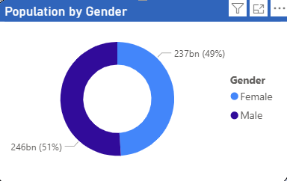
What is the composition of the male and female populations worldwide?
Globally, the male and female populations are distributed almost equally, with only minor variations.

Slide 10
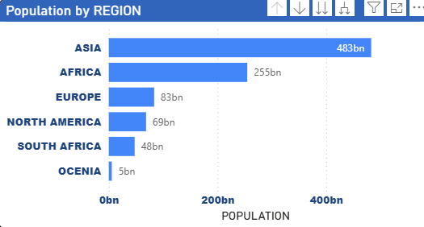
Which region is highly populated?
Of all the regions, Asia has the largest population, followed by Africa in second place,
with Oceania being the least populated

Slide 11
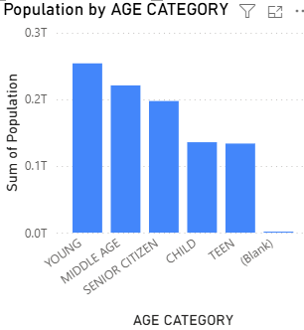
Which age group category has the highest population?
Largest Groups: The Young and Senior Citizens categories are the most populated, each representing 25%
of the total population.
Smallest Group: Teens make up the smallest share, comprising just 7% of the population.
Middle and Children: Together, the Middle-Aged and Children groups account for 37% of the population,
reflecting a significant portion in both early life and working age.
Overall, the population distribution across categories is fairly balanced, with no single group overwhelmingly
dominating.

Slide 12
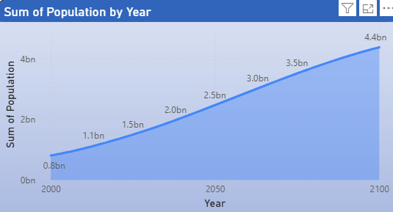
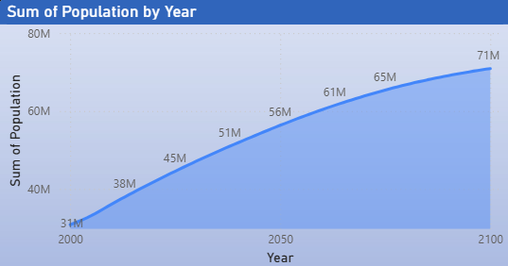
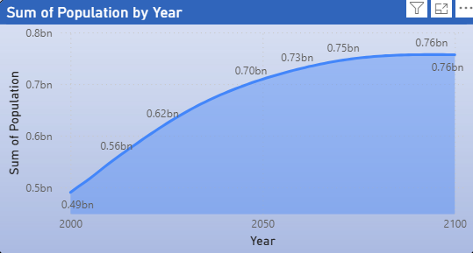
What are the population trends across all regions over the years??
Africa, Oceania, and North America exhibit a consistent upward trend in population growth over time.
Starting from relatively low levels, their populations steadily increase, reaching much higher figures
by the end of the timeline.
Africa
Oceania
North America

Slide 13
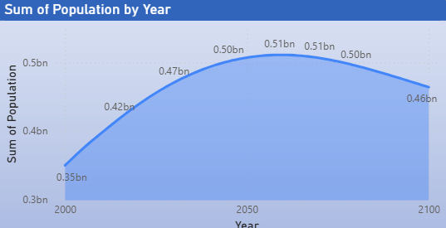
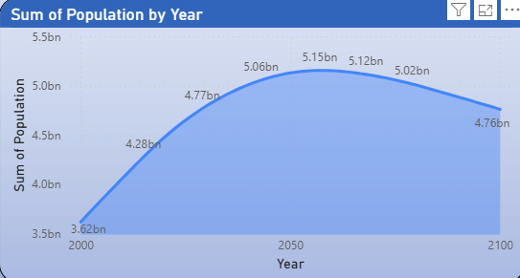
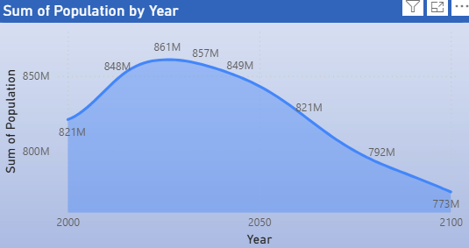
South America and Asia show a population trend that increases steadily at first, peaking in the middle of the timeline.
Following the peak, the population begins to gradually decline towards the end of the period.
Europe displays a population trend that begins with a gradual increase, reaching its peak early in the timeline.
Afterward, the population steadily declines, with the rate of decrease becoming more pronounced over time.
South America
Asia
Europe

Slide 14
RECOMMENDATIONS

Slide 15
To curb population growth in Asia, several key strategies can be implemented, including improving access to family planning, education (particularly for women), and healthcare to reduce infant mortality.
Promoting urbanization, economic development, and social security can also help lower birth rates. Governments could encourage smaller families by offering incentives and supporting delayed marriage and childbearing.
Additionally, fostering gender equality and providing workplace support for parents could further promote smaller families, striving to balance population control with an improved quality of life

Slide 16
To increase the population in Europe, several key strategies can be adopted, including offering financial incentives for families, enhancing paid parental leave, and providing affordable childcare and housing.
Policies aimed at attracting immigrants and supporting their integration, along with flexible work arrangements, can also help boost the population.
Encouraging work-life balance, promoting gender equality, and providing fertility treatments are crucial as well. Additionally, improving access to healthcare and reproductive health education, along with creating job opportunities for young people, can encourage early family planning and support family growth.
There is no immediate need to focus on increasing the population in Oceania, Africa, and North America, as these regions have already experienced consistent population growth over the years.

Slide 17
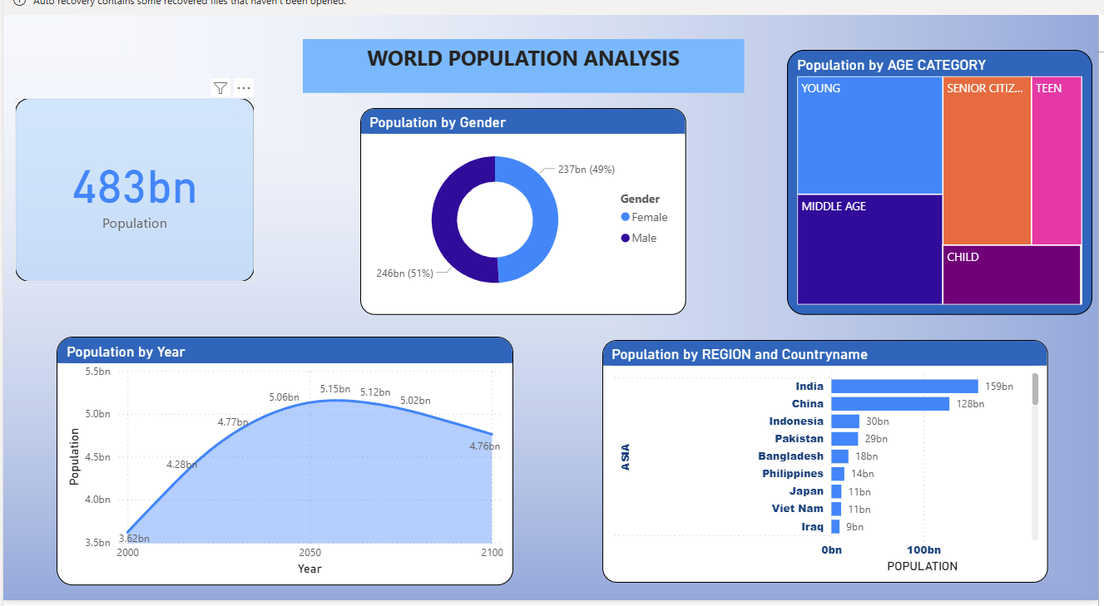

Slide 18
THANK YOU

